Slide 1
Game Concept
leah

Slide 2
Intro

Slide 3
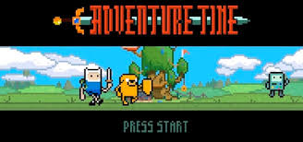
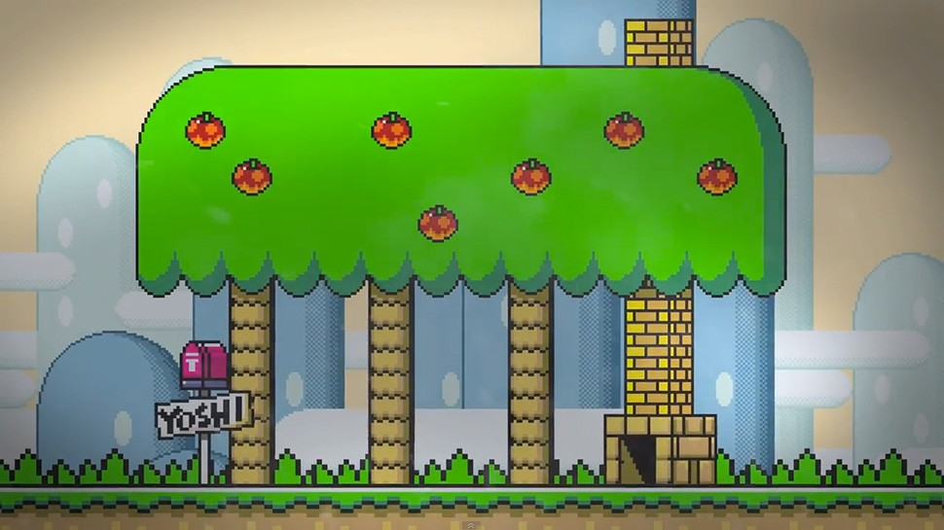
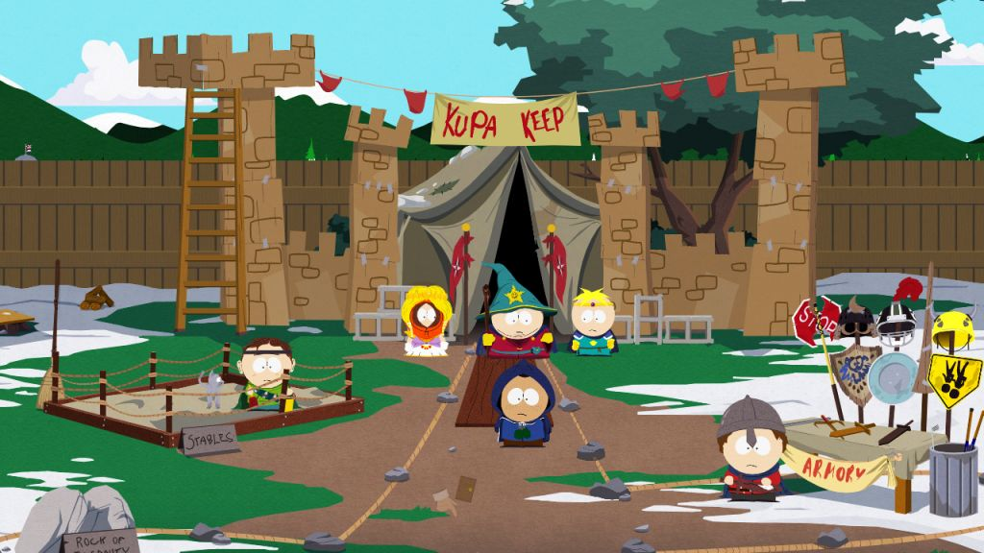
Notes:
bright and hopeful mood

Slide 4
Description

Slide 5
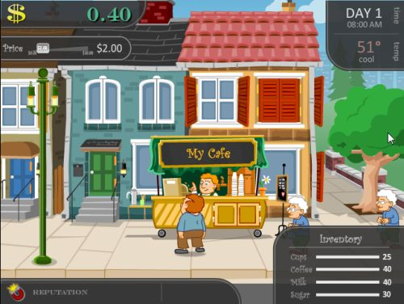
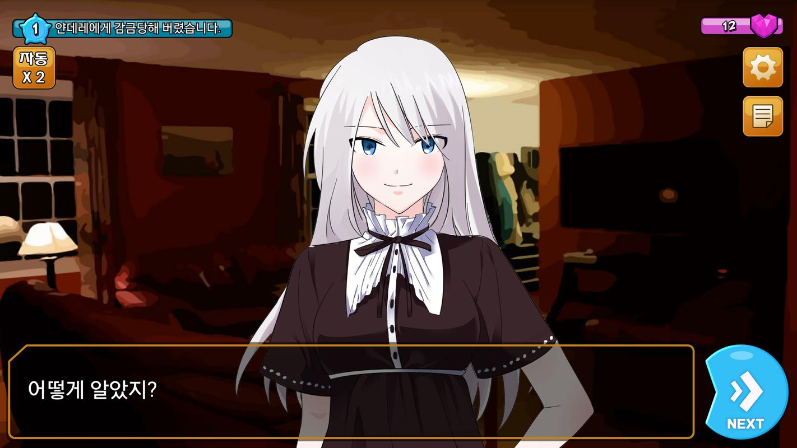
simulation game
Notes:
i think the simulation game is good for our topic. by creating virtual schools and homes and experiencing them indirectly, children will be able to feel their own cyberbullying.

Slide 6
Platform

Slide 7


online game
mobile game
Notes:
accessibility

